Slide 1
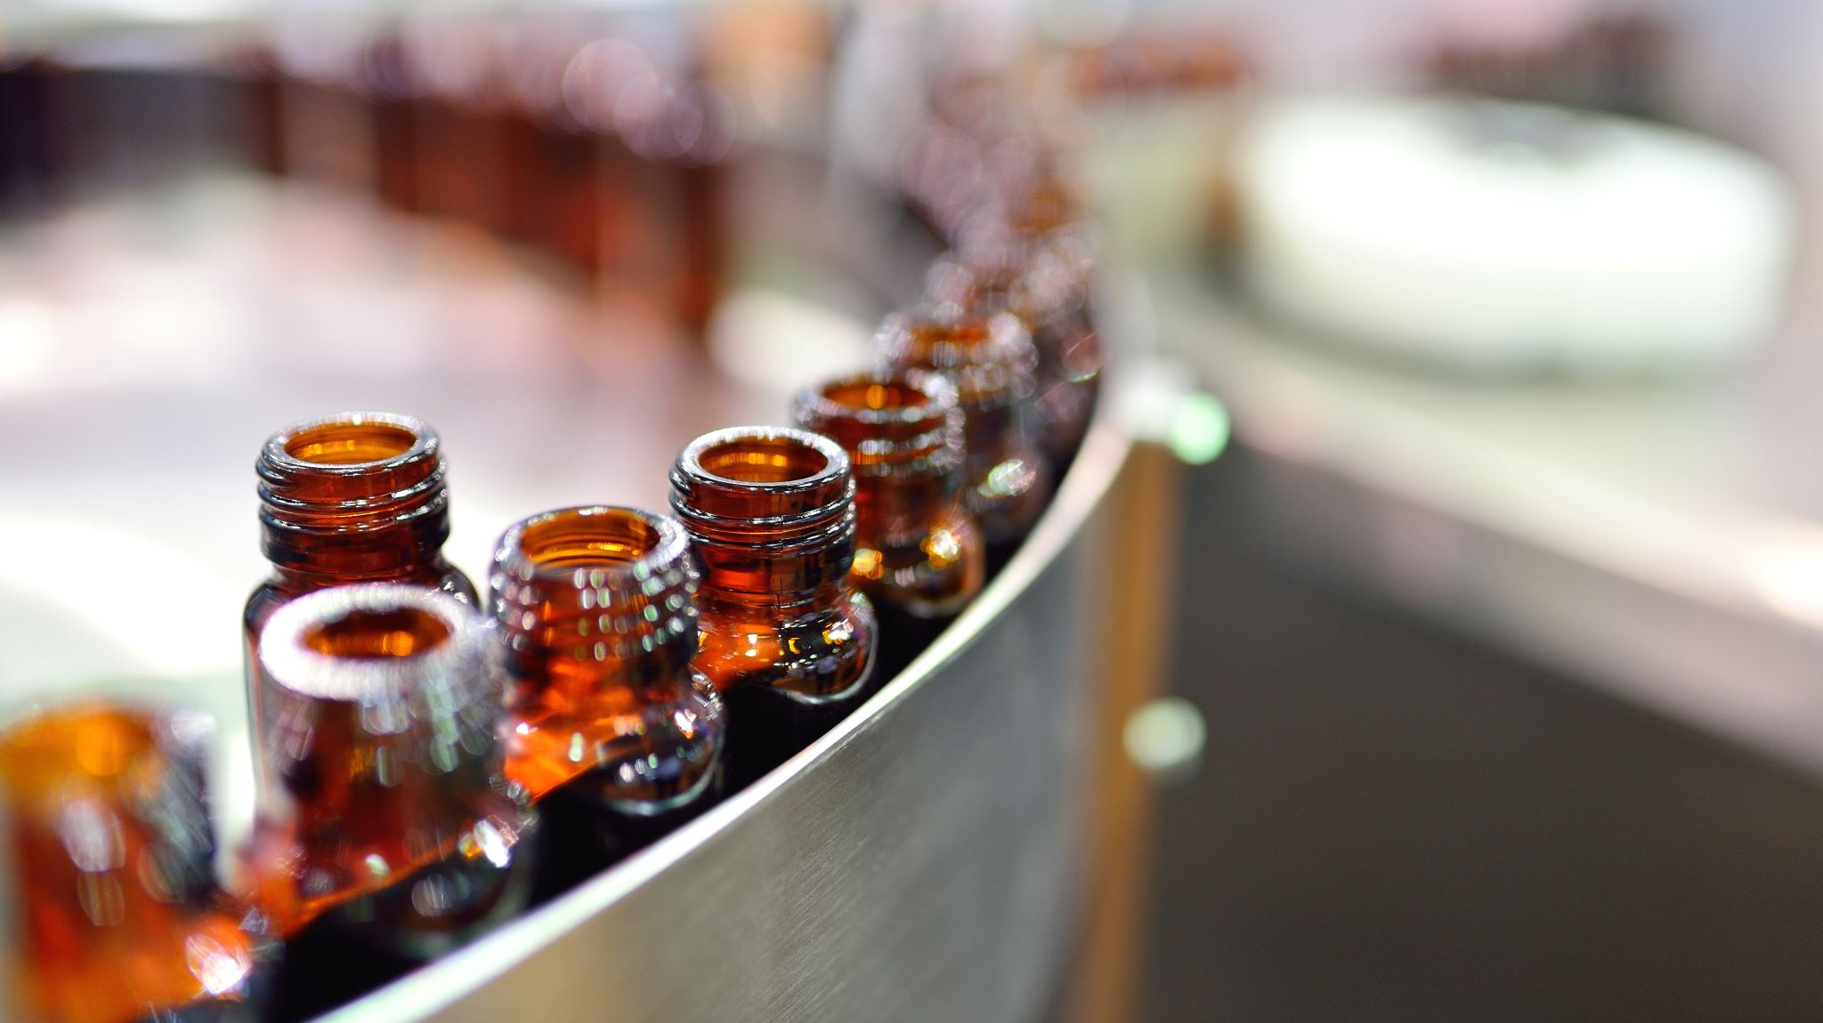
Optimizing Craft Beer Production and Sales: Analyzing Factors Affecting Quality ,Efficiency, and Alcohol Content
By
Charan Kumar Pathakamuri,
Srinivasan Lakkala,
Sherin Feno Kumaresan

Slide 2

Data Overview
Data Source: The data set was taken from Kaggle. Size of the dataset is 2.4 GB (9545009 X 20).
Link: Brewery Operations and Market Analysis Dataset
Columns: Batch ID, Brew Date, Beer Style, SKU, Location, Fermentation Time, Temperature, PH Level, Gravity, Alcohol Content, Bitterness, Color, Ingredient Ratio, Volume Produced, Total Sales, Quality Score, Brewhouse Efficiency, Loss During Brewing , Loss During Fermentation, Loss During Bottling Kegging.

Slide 3
Introduction
This Dataset has Various Potential Analysis.
We have united different splits (10) of Data into single Data Frame.
Data Cleaning
Feature Engineering: We have derived some columns which are useful for Data Analysis.
Machine Learning: Model Training and evaluating
Drawing Insights.

Slide 4
Problem Statement
Alcohol trends and Market requirements change
Addressing the Efficiency of Brewery.
Finding the different losses and which is most effecting.
Finding the most efficient beer style.

Slide 5
PROJECT EXECUTION OVERVIEW
Data Collection and Cleaning
Process: Gathered NIST data on environmental metrics and solar panel performance.
Cleaning: Addressed missing values, outliers, and inconsistencies to ensure data quality and reliability.
Exploratory Data Analysis (EDA)
Objective: Analyzed the data to uncover patterns, trends, and relationships that inform the model's development.
Tools Used: Utilized statistical tools and visualization libraries to examine data distributions and correlations
.Machine Learning
Approach: Developed predictive models to estimate optimal solar panel placement based on historical data.
Regression MOdel: Chosen for their robustness and effectiveness in handling varied and complex data structures.
Pipeline Technique
Implementation: Created a streamlined process using pipeline techniques to automate the flow of data through various preprocessing and modeling steps.
Benefits: Ensured consistency in data handling and model application, enhancing reproducibility and efficiency.

Slide 6

Objective
The objective of this project is to uncover actionable insights to improve the brewing process, optimize resource utilization, enhance product quality, and maximize profitability.
To build predictive model for estimating Quality.
Giving ideas to Manufacturers.

Slide 7
Model
Input variable: Fermentation time, Temperature
Target variable: Alcohol content
Logistic Regression:
Accuracy: 0.500078785792792
Linear Regression:
Root Mean Squared Error (RMSE) on test data = 0.4240858211120456

Slide 8

Insights: Market Analysis and Trends

Slide 9
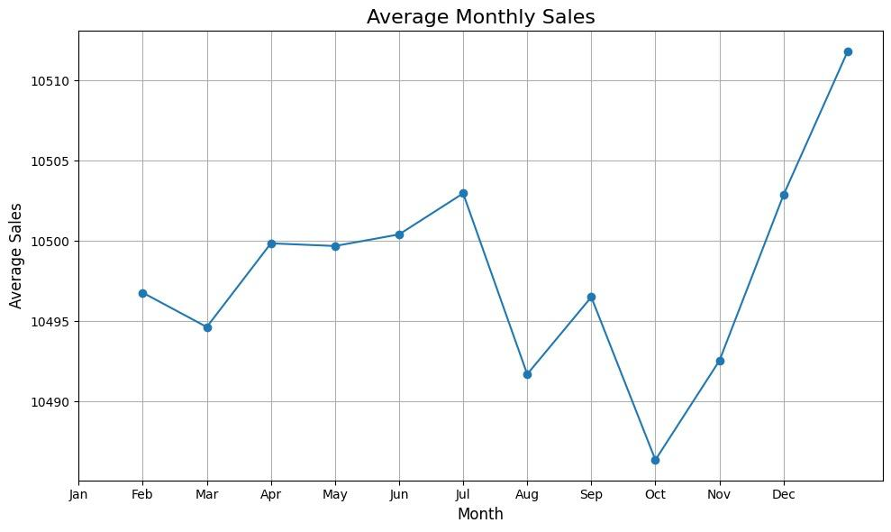

Slide 10
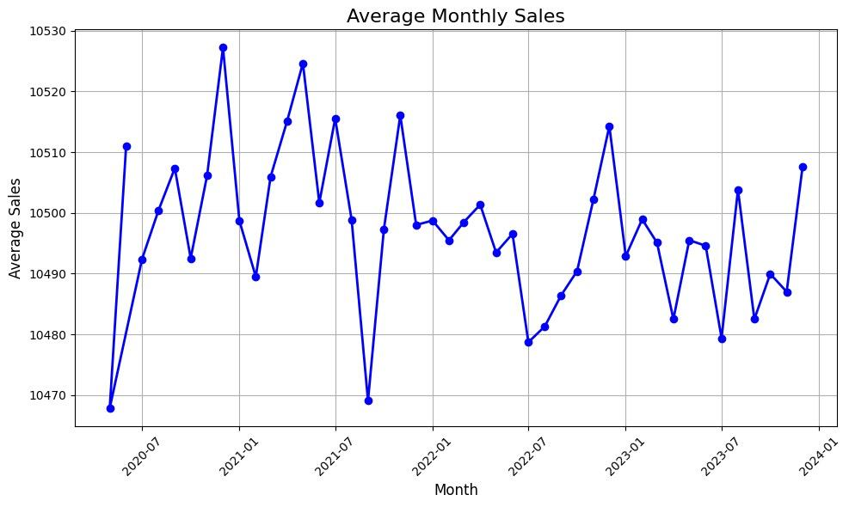

Slide 11
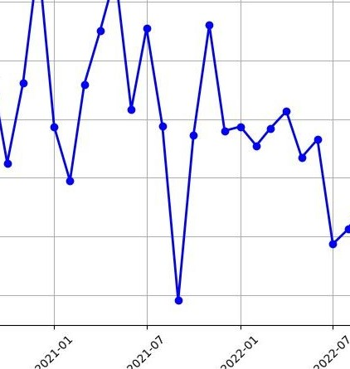


Slide 12
In dec 2021, sales of alcohol has been decreased due to impact of COVID-19. Generally, It is the best month for the alcohol sales.

Slide 13
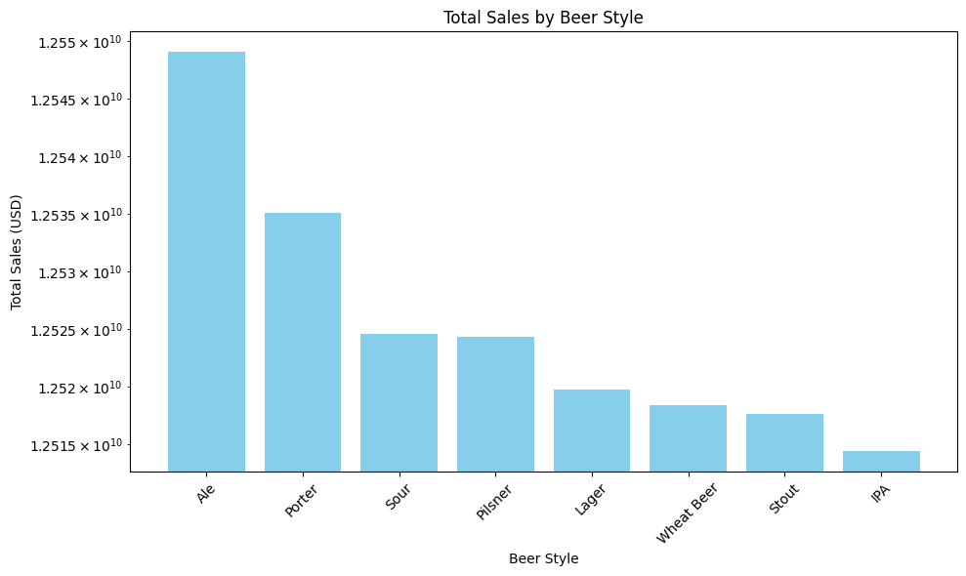
Trend Analysis: Ale is the most sold beer style.

Slide 14
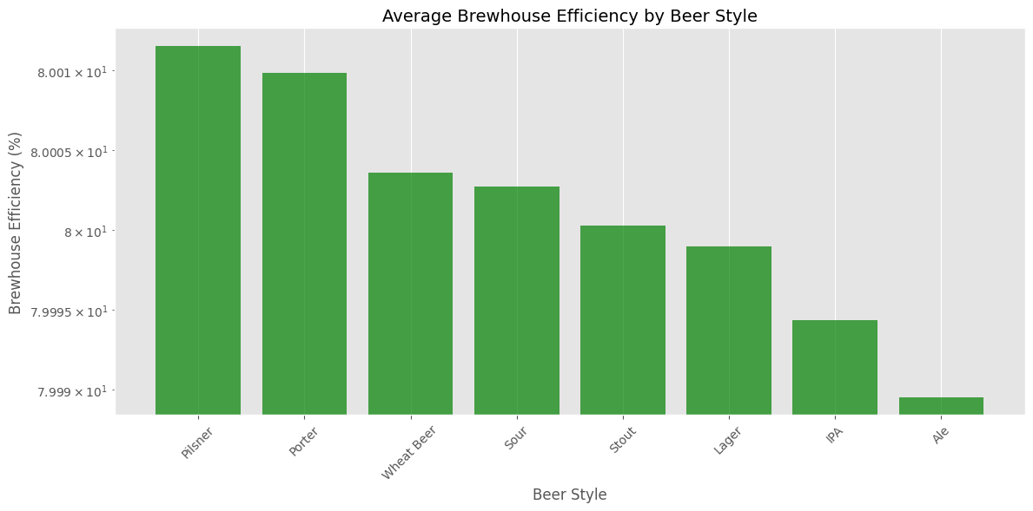
Average Brew House efficiency by Beer Style

Slide 15
Idea 1
Ale is the least efficient beer style, but it is most sold beer style so, manufacturers need to come with new style of manufacturing methods to increase the efficiency

Slide 16
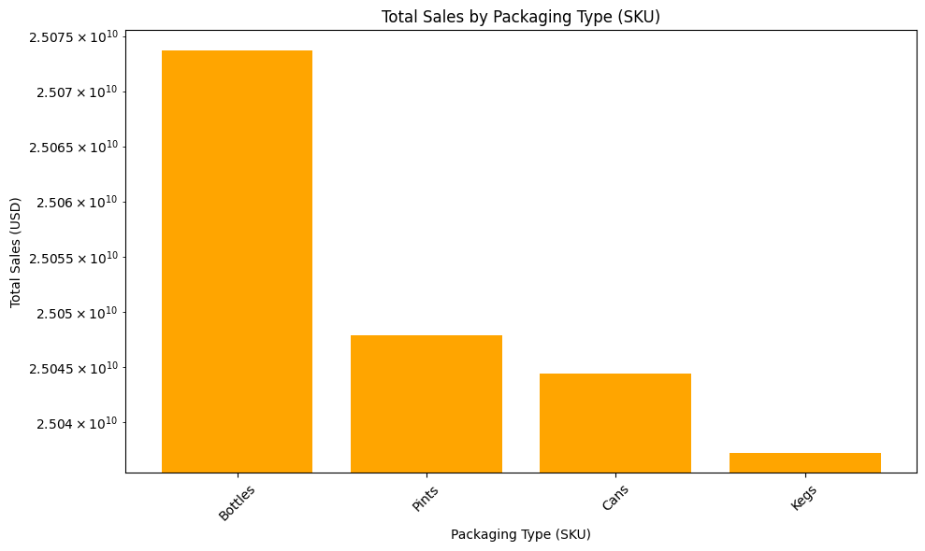
Total Sales by Packaging Type

Slide 17
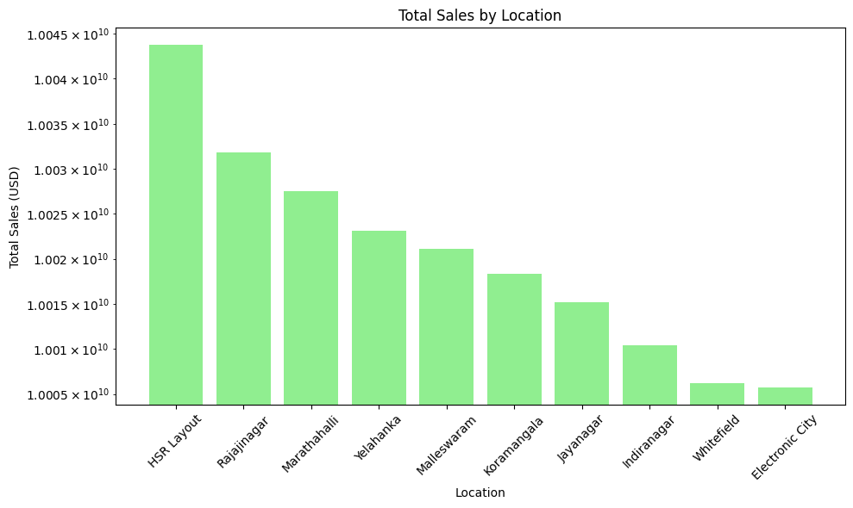
Total sales by location

Slide 18
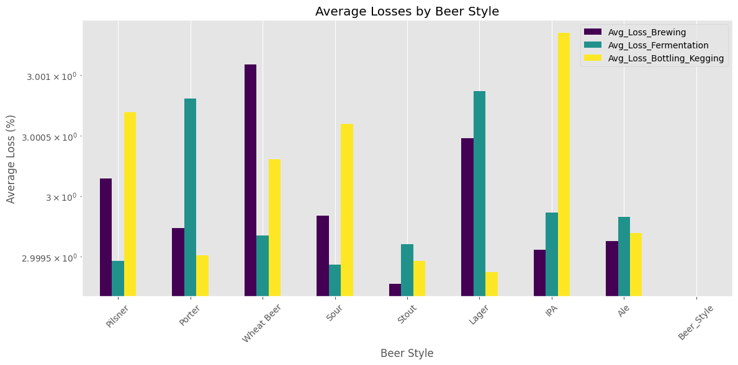
Average kinds of losses by Beer Style

Slide 19
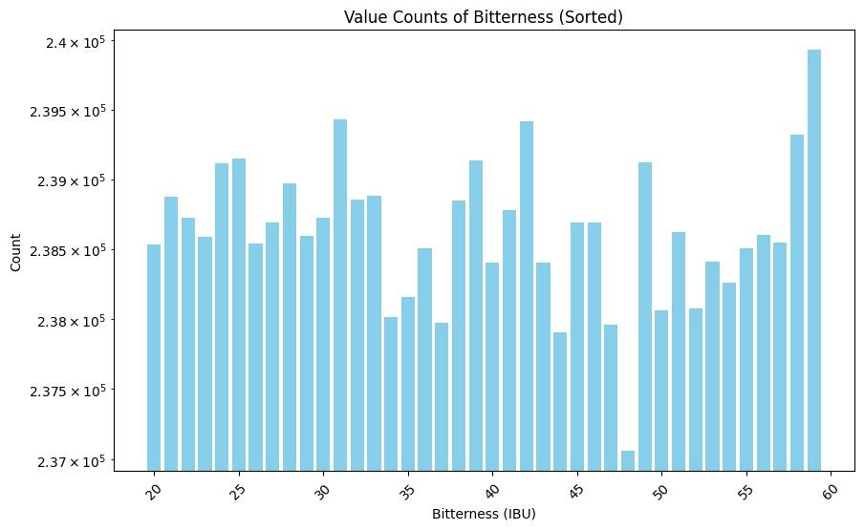
Distribution of beer production based on bitterness

Slide 20
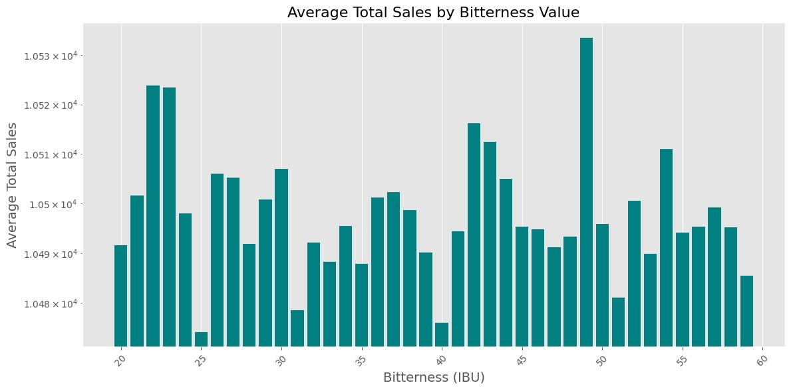
Average Sales by Bitterness

Slide 21
Idea 2:
Manufacturing of level 59 bitterness is very high, but sales are not up to the mark.
The production of level 49 bitterness can be increased since they have high amount of sales.

Slide 22

Conclusion
The brewing industry thrives on efficiency, precision, and innovation. Through our analysis of the extensive dataset, we uncovered key insights that can significantly impact both the quality of the product and the profitability of the operations.
By leveraging Apache Spark on Databricks, we achieved scalability, speed, and a seamless collaborative environment for big data analytics and machine learning.

